Slide 1
CERN openlab presentations
Don’t forget to delete this slide!
Below are slides that may be useful in creating your presentation. They can be used to give a brief overview CERN openlab and its work. Feel free to include as many or as few of these slides as you see fit.
Add new blank slides (of various layouts, but all with the CERN openlab formatting), by clicking the drop-down arrow alongside ‘add new slide’.
If you are unsure about how to use these slides, or would like any guidance about presenting CERN openlab’s work, please contact Andrew Purcell.
These slides are continuously updated by the CERN openlab communications team. The latest versions (4:3 and 16:9) are available at http://www.cern.ch/openlab/templates.

Slide 3
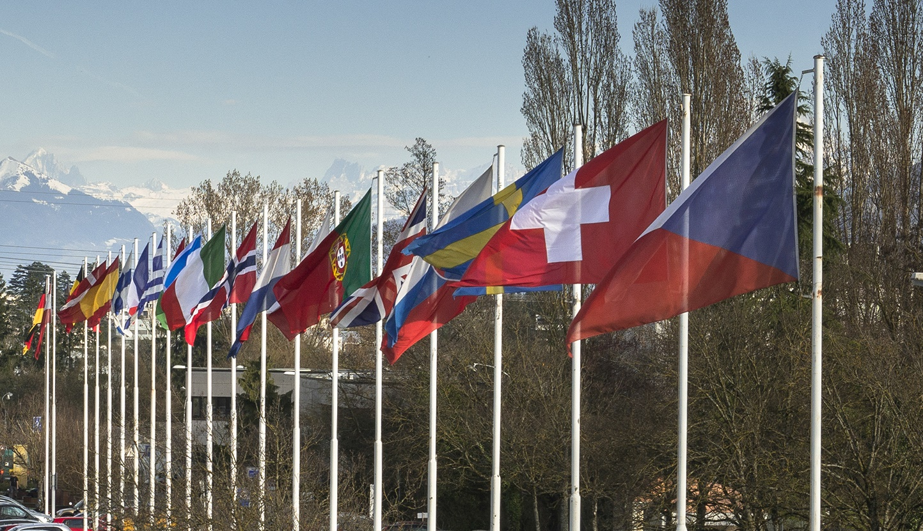
WHAT IS CERN?
European Organization for Nuclear Research
Member States:
Austria, Belgium, Bulgaria, Czech
Republic, Denmark, Finland, France, Germany,
Greece, Hungary, Israel, Italy, Netherlands, Norway,
Poland, Portugal, Romania, Slovakia, Spain, Sweden,
Switzerland and United Kingdom
Associate Members in the Pre-Stage to Membership:
Cyprus, Serbia
Associate Members:
India, Pakistan, Turkey, Ukraine
Observers to Council:
Japan, Russia, United States of
America, the European Commission, Joint Institute for
Nuclear Research and UNESCO
~ 3 000 members of personnel
~ 12 000 users
Budget ~ 1 100 MCHF per year
FOUNDED IN 1954

Slide 4
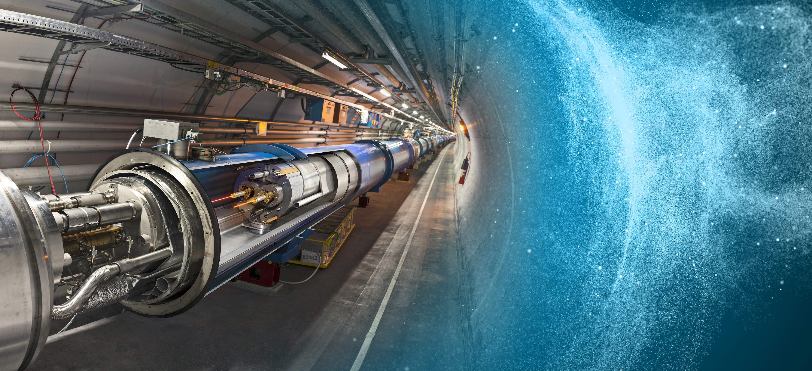
CERN: A UNIQUE ENVIRONMENT
Pushing technologies to their limits

Slide 5
A VIRTUOUS CYCLE
Driving ICT innovation in science

Slide 6
CERN OPENLAB’S MISSION
Our recipe for success
• Evaluate state-of-the-art technologies in a
challenging environment and improve them.
• Test in a research environment today
technologies that will be used in many business
sectors tomorrow.
• Train the next generation of
engineers/researchers.
• Promote education and cultural exchanges.
• Communicate results and reach new audiences.
• Collaborate and exchange ideas to create
knowledge and innovation.

Slide 7
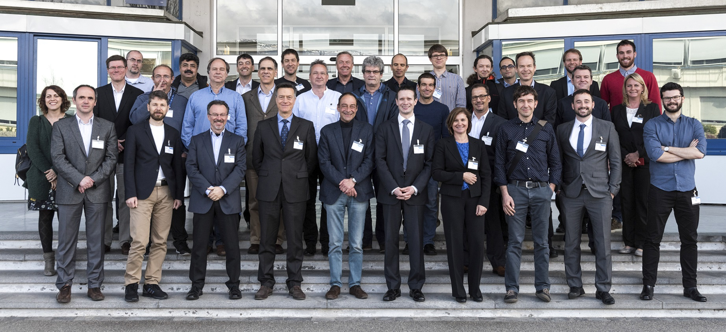
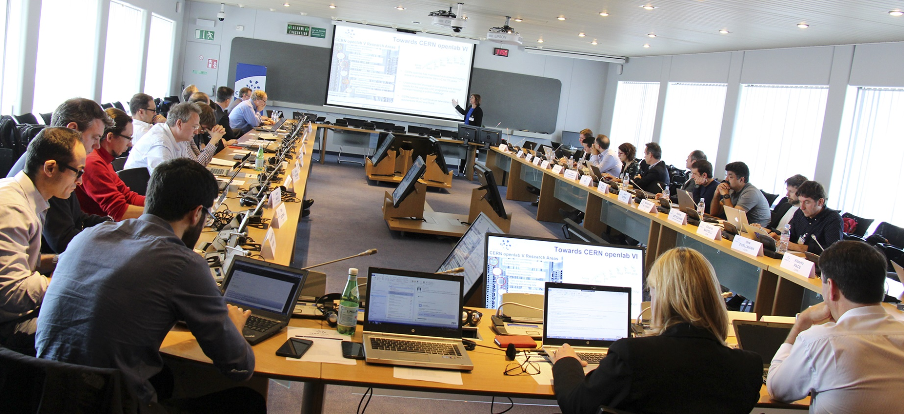
DRIVING INNOVATION SINCE 2001
Entering our sixth three-year phase
CERN openlab Collaboration Board 2017

Slide 8
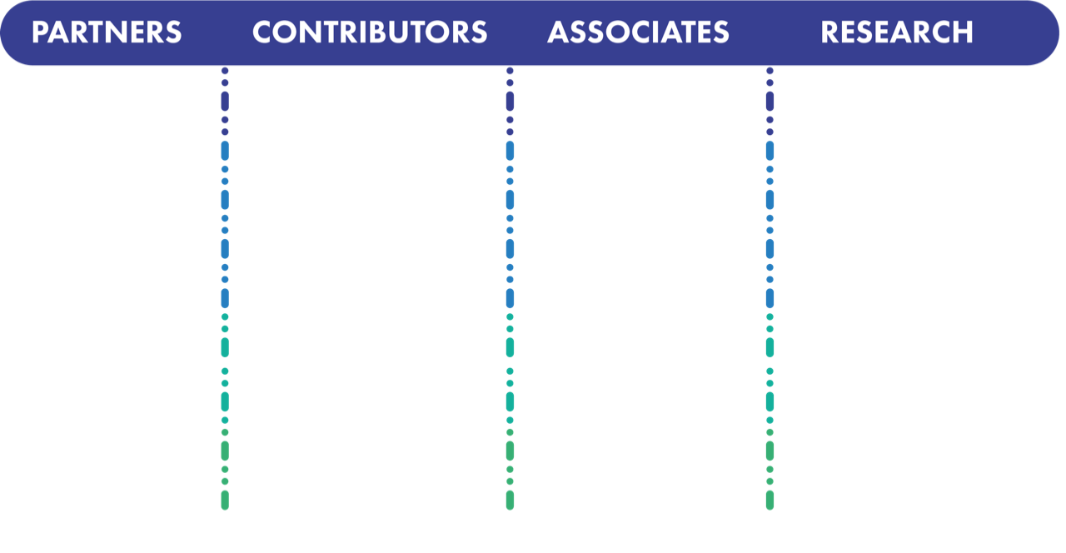

















COLLABORATION MEMBERS
A public-private partnership between the research community and industry

Slide 9
ICT RESEARCH AREAS
Tackling tomorrow’s ICT challenges today
Data acquisition and filtering
Collecting data
Compute management and provisioning (cloud)
Managing resources for processing
Networks and connectivity
Connecting resources
Computing platforms, data analysis, simulation
Improving processing and code efficiency
Data storage architectures
Storing and serving data
Data analytics
Extracting information

Slide 10
KNOWLEDGE SHARING
Working with communities beyond high-energy physics
Working closely with research institutes worldwide on initiatives aimed at sharing tools, skills, and knowledge between the high-energy physics community and other research fields.
Examples of ongoing projects related to biomedical research.
BioDynaMo
Developing a cloud-based platform for modelling biological development.
GeneROOT
Using ROOT to analyse and share large genomic data sets and pipelines.
BigHealth
Integrating health data from diverse sources for systems-biology studies.

Slide 11
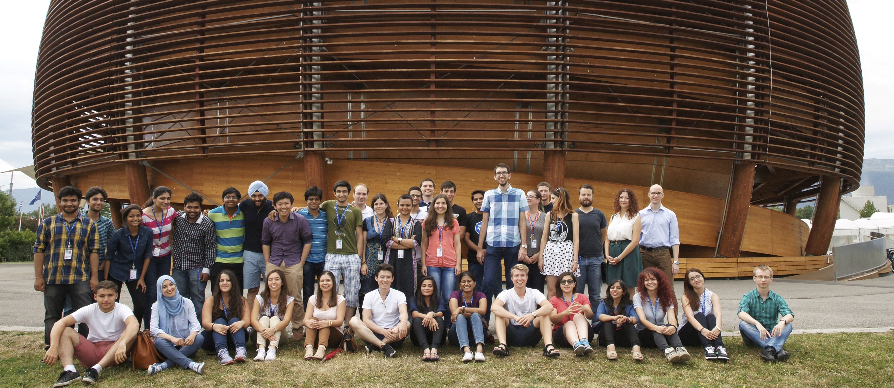
EDUCATION AND TRAINING
Training tomorrow’s leaders in ICT

Slide 12
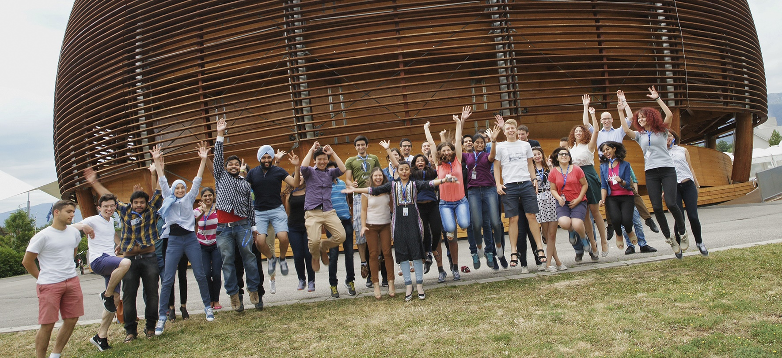
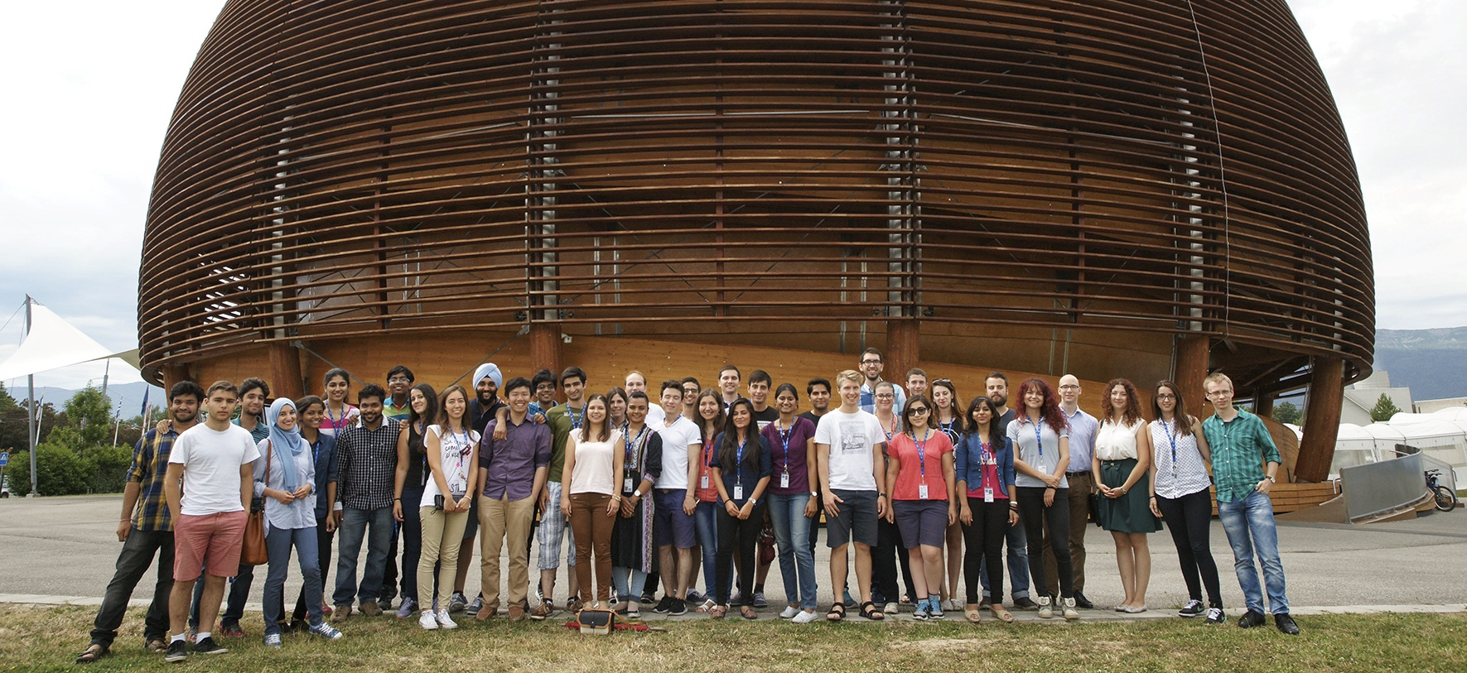
EDUCATION AND TRAINING
Training tomorrow’s leaders in ICT
CERN openlab runs a highly competitive summer-student programme
Most dedicated CERN openlab personnel are young, talented ‘fellows’.
Workshops, training courses, and other initiatives run with our collaborators.
Experts from industry and research give lectures.
~ 40 students selected from around 1500 applicants
Receive hands-on experience with cutting-edge technologies
Competitions, challenges, online training, hackathons.
Participate in events both inside and outside CERN.

Slide 13
EDUCATION AND TRAINING
Training tomorrow’s leaders in ICT
CERN-hosted
WORKSHOPS
on advanced topics
Publication of TECHNICAL PAPERS AND POSTERS
Contributors to the CERN SCHOOL OF COMPUTING
On-site LECTURES
for summer students
JOINT EVENTS with industry members
Technical SEMINARS from
CERN staff or invited guests
KEYNOTE PRESENTATION
at leading global events

Slide 14
CERN OPENLAB’S WORK
Association with the WORLD’S LEADING INNOVATORS in the IT industry
Unique TESTING ENVIRONMENT in terms of scale and complexity
Recruitment channel for HIGHLY SKILLED AND TRAINED young IT specialists
Engagement of multi-disciplinary CERN EXPERTS collaborating on joint projects
DISSEMINATION OF RESULTS as success stories to a wide range of audiences

Slide 15
QUESTIONS?
Your email address
Other contact (e.g. Twitter)

Slide 16

CONTACTS
ALBERTO DI MEGLIO
CERN openlab Head
alberto.di.meglio@cern.ch
ANDREW PURCELL
CERN openlab Communications Officer
andrew.purcell@cern.ch
MARIA GIRONE
CERN openlab CTO
maria.girone@cern.ch
FONS RADEMAKERS
CERN openlab CRO
fons.rademakers@cern.ch
KRISTINA GUNNE
CERN openlab Administration/Finance Officer
kristina.gunne@cern.ch
www.cern.ch/openlab

